Slide 1
Agenda
How to use testing framework
Create class
Rules
Client

Slide 2
Current Problem
Hard to achieve high automation rate
Each QA program themselves testcases
QA has no time to program testcases
Hard to maintain the automatic testcase
Code can’t re-useable
Code unreadable
Hard to create previous testcase
Language SDK & framework
C#、PERL、VB、JAVA、RUBY 、Python
WATIN vs WATIR vs PAMIE vs Selenium
AutoIT vs Accessibility

Slide 3
AUTOMAN Target
Data driven
Key-word driven
Manual QA can use each module’s command and easy to write a script for test
Manual QA only need to take care about “script”
QA dev can follow the rule to create command and module
Create a standard framework for manual QA and QA dev

Slide 4
Session I
How to use testing framework

Slide 5
Framework - Architecture
qa
Computer
Script.qa
qas
Automan
Env.ini
Ssh/Scp
Storage
UI
Browser
Class
Normal
Web Server
Autoit
Log
Windows App
Sikuli
Facebook

Slide 6
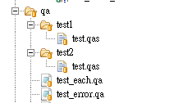
Framework – QA Script
include sub.qa
ini test.ini
start
set Tool dir #key#=10
$test$=Get Tool foldernumber
each start $test$,100,200
verify Tool dir #name#=test,#value#=$$ ,#key#=$test100$,#criteria#==
each end
verify Tool dir #name#=test,#value#=100,#key#=$test100$,#criteria#==
verify Tool dir #name#=test,#value#=100,#key#=$test100$,#criteria#=!
end
Testcase
qa
Test Suite
qas
test.qa
test_error.qa

Slide 7
Framework – Keyword
Include
Join other qa script
Ini
Read ini file into Dict
Start
XD
Each
each start value1,value2,…..
Use $$ as the value
end each
Sleep
Sleep sec
End

Slide 8
Framework – Ini
ini xxxx.ini
Default system.ini
Ie=http://xxxx.com
keepgoon=yes
sleep=1
chrome=http://test.com
sleep=1
screenshot=yes
init ie Chrome
Folder -> ini
Overwirit
Python Dict

Slide 9
Framework – Include
Include xxxxx.qa
Read xxxx.qa
Insert current qa script
Use include is the best way to test our product

Slide 10
Framework – Dict
Get
$key$=get Class vmnumber
Ini
ini FC.ini
Qa script
$vmnb$=get VM vmnumber
verify Tool vmnumber #name#=vmnb,#value#=2,#key#=$vmnb$,#criteria#==

Slide 11
Framework – Each
Loop with same statement
Use $$ as the pramater
each start 300,200,100 ($a$,$b$)
verify Tool dir #name#=test,#value#=100,#key#=100,#criteria#==
verify Tool dir #name#=test,#value#=$$,#key#=$test100$,#criteria#=!
each

Slide 12
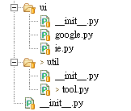
Framework – Object
Util
tool.py
xxxx.py
UI
ie.py
google.py
xxxxx.py
ini test.ini
start
verify Tool dir #name#=xxx,#value#=11,#key#=$xx$,#criteria#==
$test100$=get Tool test
verify Tool dir #name#=test100,#value#=11,#key#=$test100$,#criteria#==
verify Tool dir #name#=xxx,#value#=11,#key#=$xx$,#criteria#=!
end
Ini test.ini
start
set ie.Google textbox_search #key#=$test1$
click ie.Google button_submit
end

Slide 13
Framework – Verify
Ini
test1=hello
test=100
test100=100
Verify Tool dir #name#=test,#value#=100,#key#=100,#criteria#==
Verify Tool dir #name#=test,#value#=$test100$,#key#=$test100$,#criteria#==
Verify Tool dir #name#=test,#value#=$test100$1,#key#=$test100$,#criteria#==
== Standard ==
$testvalue$=get Tool test
Verify Tool dir #name#=test,#value#=100,#key#=$testvalue$,#criteria#==
Verify Tool dir #name#=test,#value#=$test100$,#key#=$testvalue$,#criteria#==

Slide 14

Framework – Log
XML format for Hudson
Folder -> log->test suite -> test case

Slide 15
Session II
Create Class

Slide 16
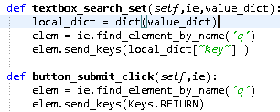
Create Own Class – Flow
Set ie.Google textbox_search #key#=$test1$
Define Step
Define UI/Util
Define Class
Define Function
Define Keyword

Slide 17
Create Own Class – UI
Browser Driver Object
init ie
UI Class (per page)
google.py
netgear3234.pt
……
def __init__(self,url):
self.ie = webdriver.Firefox()
self.ie.get(url)
set ie.Google textbox_search #key#=$test1$
click ie.Google button_submit
set ie.netgear3234 textbox_login #key#=$test$

Slide 18
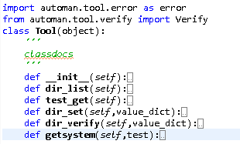
Create Own Class – Util
Class name “Xxxx”
Pre function
tool.py
vm.py
storage.py
ssh.py
…….
Qa function
Member function

Slide 19
Create Own Class – Function name
def dir_verify(self,value_dict):
print value_dict
local_dict = dict(value_dict)
#get value from system
try:
system_value = local_dict['key']
local_dict['system_value'] = system_value
Verify().verify(local_dict)
except error.equalerror:
raise error.equalerror()
except error.notequalerror:
raise error.notequalerror()
except:
raise error.nonamevalue()
Keyword
Set
Get
Click
Verify
….
Object_text
Textbox_username
Button_submit
…
Function name
Def Object_text_keyword(self, value_dict)

Slide 20
Create Own Class – Parameter
Set
set ie.Google textbox_search #key#=$test1$
Verify
verify Tool vmnumber #name#=test,#value#=100,#key#=100,#criteria#==
verify Tool vmnumber #name#=test,#value#=100,#key#=$test$,#criteria#=!
def textbox_search_set(self,ie,value_dict):
local_dict = dict(value_dict)
elem = ie.find_element_by_name('q')
elem.send_keys(local_dict[“key"] )
def dir_verify(self,value_dict):
local_dict = dict(value_dict)
#get value from system
try:
system_value = local_dict['key']
local_dict['system_value'] = system_value
Verify().verify(local_dict)

Slide 21
Create Own Class – Verify
verify Tool vmnumber #name#=test,#value#=100,#key#=$test$,#criteria#=!
Use default verify class
Use local_dict
value
system_value
Verify().verify(local_dict)
Compare with value and system_value
def dir_verify(self,value_dict):
local_dict = dict(value_dict)
#get value from system
try:
system_value = local_dict[‘key']
local_dict['system_value'] = system_value
Verify().verify(local_dict)
except error.equalerror:
raise error.equalerror()
except error.notequalerror:
raise error.notequalerror()
except:
raise error.nonamevalue()

Slide 22
Create Own Class – Output
Get
Value
Verify
Raise
Pass/No return
Other keyword
No return

Slide 23
Session III
Rules

Slide 24
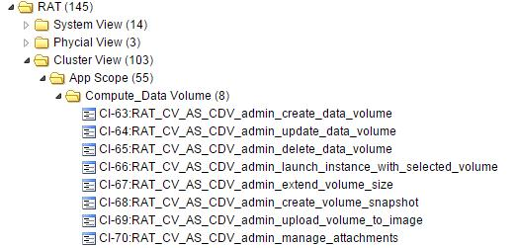
Python file Naming Rules
QA file name should be all lowercase and follow the test case from testlink
Example : rat_cv_as_compute_datavolume.py

Slide 25
config Naming Rules
1. There are two main types of format following the
section type: Each line is variable = value , Each line is
a just an EOL terminated string.
2. Configuration variable name , if variable includes format below as, please adding type to head
Type : xpath, css , id , name
example : css_create_icon ,id_file

Slide 26
Ini Naming Rules
1. Ini The file name should be similar program file name
example : rat_cv_cs_ci_admin_image.ini
Other parameter setting use program.ini
The system.ini only setting ip address of admin portal
4. if you had some key and value,can put in system.ini, but not include ip address

Slide 27
QA file Naming Rules
QA file name should be all lowercase and follow the test case from testlink
Example : rat_cv_as_cdv_admin_create_data_volume.qa

Slide 28
Program Naming Rules
1. Class name Rules
Class name should be all lowercase
2. Function name Rules
N+N => textbox_name
S=> network, ram , disk , Button , link , textbox ,
V=create ,delete , update , import , submit
S+V
Example : name_import_set
use the underscore symbol (_)

Slide 29
Session V
Client

Slide 30
Architecture
automan_server
automan_client
1
TCP socket
Class
TCP socket connection
Send request
Get response
Verify result
Main class
Call_function()
Threadwork()
TCP socket
2
Send request
3
Send response
Script.qa
Function_class1
Function_class2
Config.ini
Host
Port
request
Function_classN

Slide 31
Automan Client - Main Class
Socket_server
Create TCP socket
Keeping listening
Create a thread to do requested task
Threadwork
Receive request from automan server (socket client)
Send request to Call_function()
Receive response from Call_function()
Return the response to automan server
Call_function
Analysis request and send parameters to call the corresponding function
Receive response from the corresponding function and return that to threadwork()
Start_new_thread()
Socket_server()
Threadwork()
Send request
Send response
Call_function()

Slide 32
Automan Server
Based on automan architecture, use qa script to trigger automan server(socket client) to send request to automan client (socket server).
Receive response from automan client (socket server), and verify the return value.

Slide 33
Automan Server
$result$=get Automan_client result #ip#=$host_ip$,#port#=$port_number$,#action#=$request$
class Automan_client(object):
def result_get(self,value_dict):
.
.
host = (local_dict[“ip”])
port = int(local_dict[“port”])
sock.connect ((host,port)) .
.
action = (local_dict[“action”])
sock.sendall(action)
.
.
Give the Host and Port that can connect to automan client (socket server).
Send request that send to automan client (socket server).

Slide 34
Automan Server
$result$=get Automan_client result #ip#=$host_ip$,#port#=$port_number$,#action#=$request$
host_ip=127.0.0.1
port_number=10000
request=function_class,Function_class,hostname_verify,ip:10.10.10.2
Request naming rule:
request=function_class,Function_class,hostname_verify,ip:10.10.10.1
py file name
Class name
Member function name
parameter
＊Parameter are colon separated fields

Slide 35
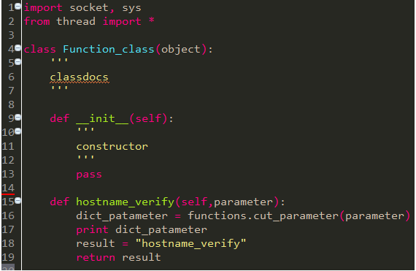
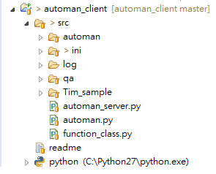

Automan Server
request=function_class,Function_class,hostname_verify,ip:10.10.10.1

